Slide 1
Long Island Population Health Improvement Program
(LIPHIP)
WIFI password: kayla1393
May 17, 2017
This meeting is now being recorded.

Slide 2

Announcements and Updates
LIHC Meeting Cheat Sheet-review/feedback
Year 1-2 PHIP Work Plan Timeline
NPR Radio: PSA Audio

Slide 3
March Meeting Evaluation
Evaluation Results
  Collective Impact Think Tank
  Program Evaluation/Data Visualization Webinar

Slide 4
DSRIP Partnership Updates
Nassau-Queens PPS
Suffolk Care Collaborative

Slide 5

Nassau Queens Performing Provider System Update
Long Island Health Collaborative

Slide 6

Behavioral Health/Crisis
Integrated Behavioral Health
Developed a Behavioral Health Integration Implementation Plan that outlines how the PPS will achieve the Integrative Behavioral Health Model in both primary care and behavioral health sites.
Established vendor partnership agreements to support PCMH transformation to NCQA Level 3 recognition. LIJ has received PCMH Level 3 recognition for 3 sites.
Collaborate with the Healthix RHIO for clinical management purposes.
Behavioral Health Crisis
Utilizing existing services for Crisis Intervention: Current contracting efforts with the Crisis Hotlines (NYCWell & 227Talk) and CBO Engagement.
Developed and now implementing the Access Improvement Plan for Specialty Crisis Services that describes the Adult Walk-In at Zucker-Hillside Hospital, BH Pediatric Urgent Care Program at Cohen’s Children’s Medical Center, and the Crisis De-escalation Team on the Creedmoor Campus

Slide 7
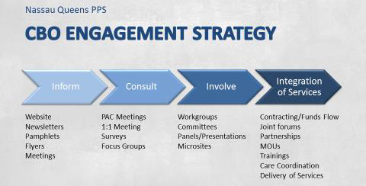
Community/CBO Engagement
CBO Engagement Strategy:
Goal is to engage and contract with 33 CBOs
Currently Hubs working with several CBOs in discussion to contract areas to address the social determinants of health.
  Educate and empower underserved communities about their health and healthcare needs.
  Identify and address gaps in care coordination and access to healthcare.
  Invest in educating and training the workforce, including community health workers, patient navigators, and peer educators.
  Assess healthcare needs and connect CBOs and providers who serve the same population to address those needs.
  Implement innovative behavioral health services to enhance access to care, care transitions, and community-based resources.

Slide 8

Cultural Competency Health Literacy & Training
Cultural Competency and Health Literacy (CCHL)
Expanding upon our existing CCHL training sessions,
Provide CCHL Train the trainer (TTT) sessions to expand the reach of the training.
  Training held April 24 with 22 individuals who completed the training in
  Additional trainings planned for Nassau County and Queens
Training
Collaborating with 1199 TEF on the development of our training portal and online curriculum library.
Employees and partner organizations access DSRIP related online training and educational programs and serve as a learning management system (LMS) to assist with tracking and reporting.
Portal Launch by end of May with trainings in:
  CCHL
  Care Coordination
  Self-Management Goals
  Cardiovascular Disease and Million Hearts campaign
  Hypertension Guidelines
  Self-Management of Blood Pressure 3 Modules

Slide 9

SNFs, ED Co-location, and INTERACT
ED Co-location
Care Management Workflow to include expansion of Care Management of the Fast Track/Express Care Patient as well as Education and materials
Developed Protocol for Health Home Notification
Care Transitions
Developed Care Transitions Framework Policy
Revised Care Transitions Workflow to include Care Manager/TOC Provider role and post-discharge processes
Adoption of Transitions of Care Provider Attestations for Hospital Based and PCP/Non-PCP
INTERACT
2.b.vii workgroup with SNF participants to begin in June 2017
Will work with SNF participating organizations, i.e. Continuing Care Leadership Coalition (CCLC), Greater New York Health Care Facilities Association (GNYHCFA) to engage remaining SNFs to fulfill commitment numbers

Slide 10

Chronic Disease Management and PCMH
Chronic Disease Management and PCMH
Workgroup meetings have been revised to include a monthly meeting focused on:
  Quality Outcomes
  Actively Engaged
  Provider Engagement
  Rate of PCMH certification
Protocols have been developed related to improving self-management and care coordination, training will be provided going forward.

Slide 11


IT & Performance Reporting
IT
IT Clinical Data Sharing and Interoperability Strategy document
complete and submitted.
Healthix Best Practices Guide: Document for Hubs to reference to facilitate the connection and utilization of Healthix by contracted providers.
Continue regularly scheduled meetings with PPS IT leads and Healthix leads
Performance Logic: Tool currently being implemented to streamline Provider>Hub project information collection process.
Performance Reporting/Quality
NQP has implemented Performance Reporting Scorecards that
focus on:
  Actively Engaged
  Contracting
  Quality Metrics
These are used as tools within our workgroups to track progress and outcomes

Slide 12
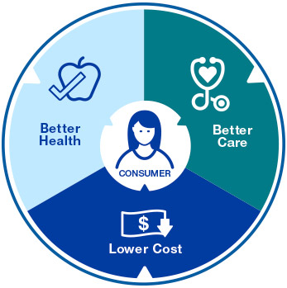
Value Based Payment
Development of VBP implementation plan based off of recent survey to Hubs and providers
Collaborating with potential VBP expert consultants to design education and training for network to support towards transformation

Slide 13
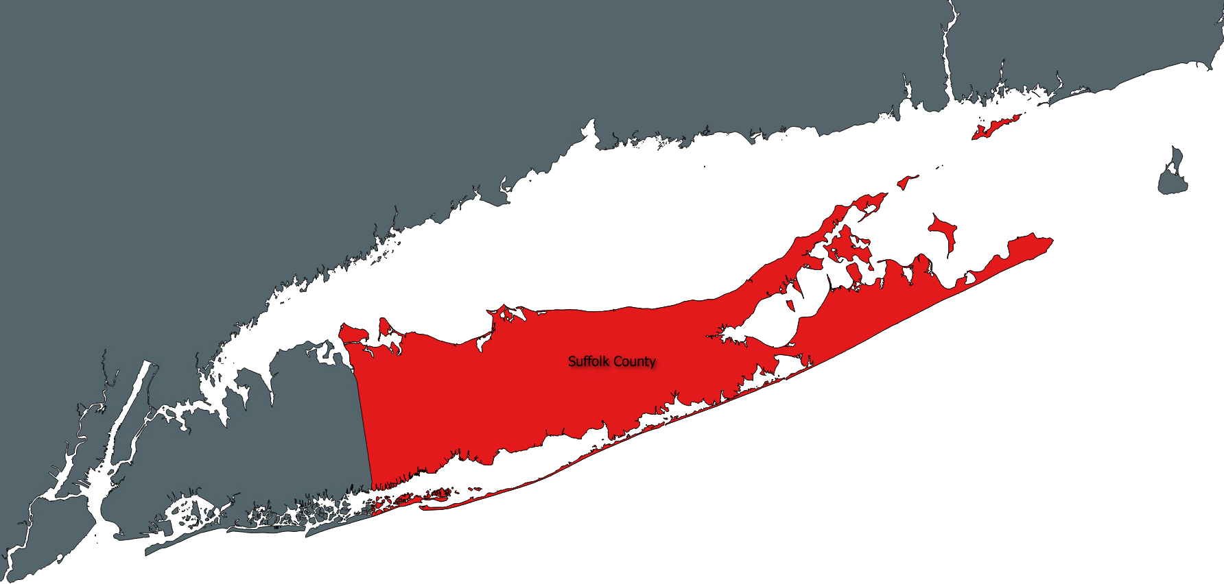
SCC updates
Community Engagement Website Launched!
CBO Survey & CBO Learning Collaborative on June 13th
Performance Gaps – Adolescents & School Districts

Slide 14

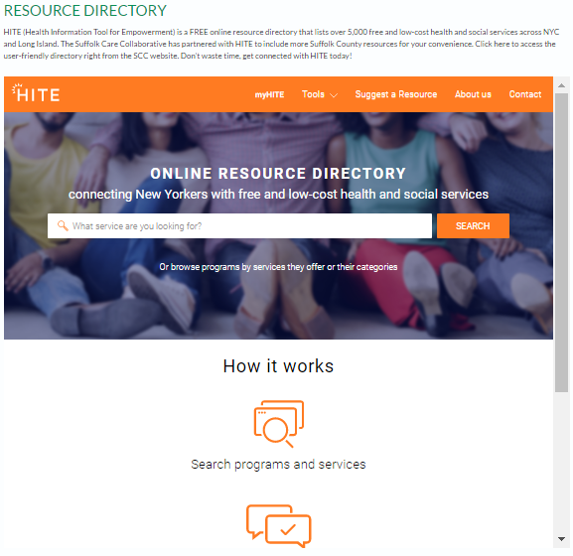
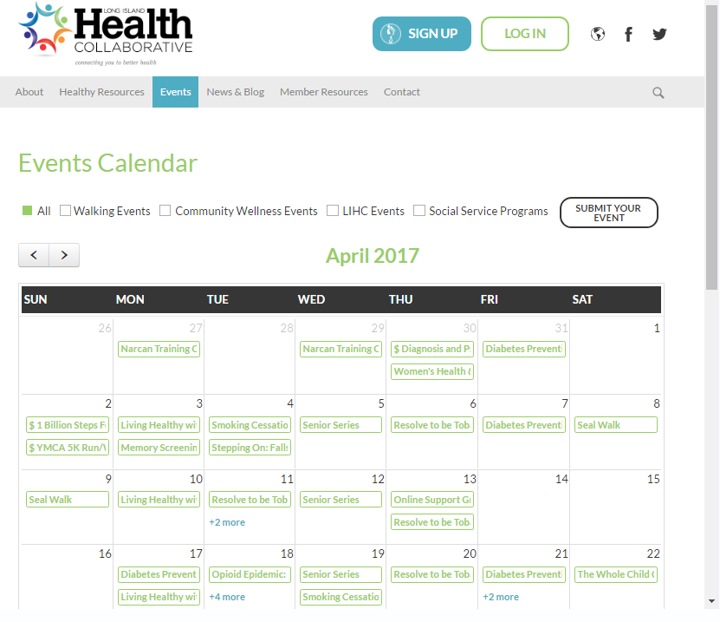

SCC updates
SCC Community Website:
www.suffolkcare.org/community
  Health Education Materials
  Community Calendar
  Health Resources
  HITE Resource Directory
Notes:
Our Community Engagement Website provides your organization and communities you serve a multitude of opportunities to conveniently access health education materials and connect with neighboring resources.
The community calendar provides your organization the opportunity to promote your events that encourages health and well-being. Furthermore, the calendar
The HITE Resource Directory provides all communities access to an extensive directory of community resources that serve to improve the livelihood and well-being in your own backyard. Whether that be pantries, transportation options, home care services, the options are endless. Furthermore, this directory will continue to grow as HITE is continuously seeks directly from communities and health professionals for additional resources to add.

Slide 15

SCC updates
CBO Survey & CBO Learning Collaborative on June 13th:
  Survey responders invited to attend
  CBO survey findings & potential cross partnership opportunities

Slide 16

SCC updates
Performance Gaps – Adolescents &School Districts:
  Amityville District: Amityville, Amityville Harbor, & North Amityville
  Brentwood District: Brentwood & West Brentwood
  Deer Park District: Deer Park
  Huntington District: Huntington, Huntington Station, & Huntington Village
  Islip District: Islip
  Patchogue-Medford District: Medford, North Patchogue, & Patchogue
  Riverhead District: Riverhead
  Shoreham-Wading River District: New Waving River, Shoreham, & Wading River
  West Babylon District: West Babylon
  William Floyd District: Mastic, Mastic Beach, Moriches, North Shirley, & Shirley
  Wyandanch District: Wyandanch

Slide 17
The Value and Challenges of Academic/Practice Partnerships
Laurel Janssen Breen, PhD, RN, CNE
Anne Little MPH, AE-C, Asthma Coalition of Long Island

Slide 18

Networking, Stretch Break & Sign up for Workgroup Participation

Slide 19
Data Workgroup
Review of PHIP Data Resources Video
Hiring of new analyst and plan for gap in staffing

Slide 20
Public Education, Outreach and Community Engagement
#ReadyFeet Rally
@LIHealthCollab Instagram Launch

Slide 21
Behavioral Health
Intersection between Chronic Disease and Behavioral Health
Engaging key partners to share valuable resources
BH VBP Readiness Program
RPC-Value Based Payments and the upcoming NOI Webinar: Thursday May 18, 2-3pm Register Here!

Slide 22
Academic Partners
Library Asset Mapping Project

Slide 23
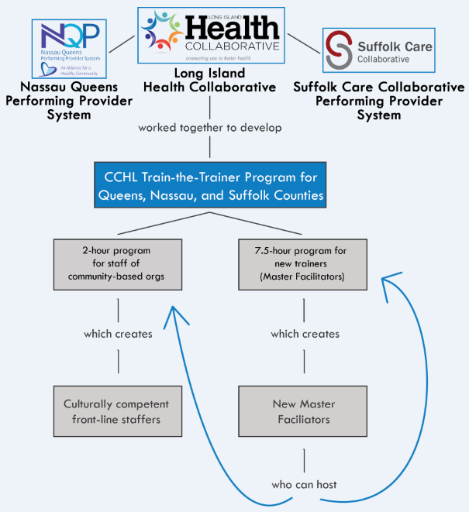
Cultural Competency

Slide 24
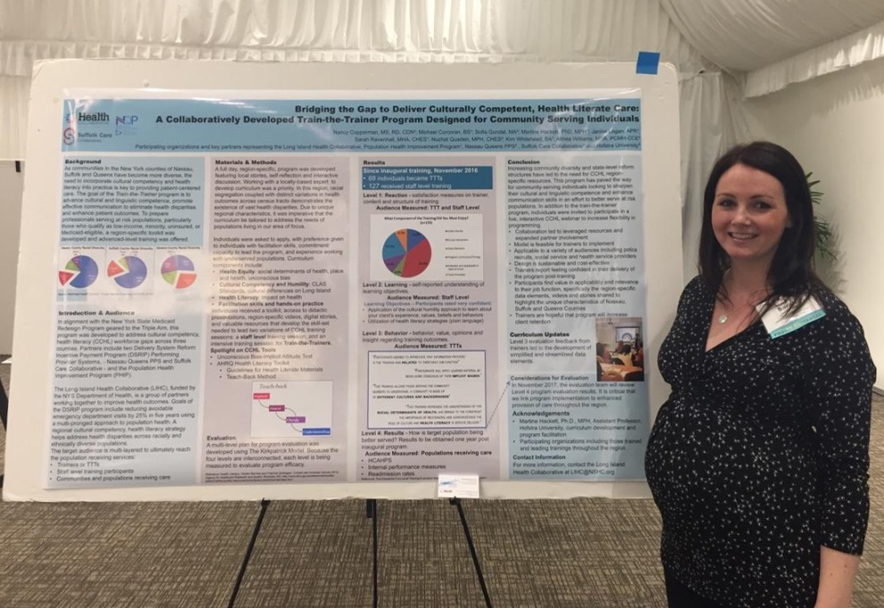
Cultural Competency
Institute for Healthcare Advancement 16th Annual Health Literacy Conference, Anaheim CA
Refresher Session for Master Facilitators

Slide 25
Walking Event-Ballot Participation
Nassau County
___ Bethpage State Park/Bikeway, Farmingdale
___ Hempstead Lake State Park, Hempstead
___ Long Beach Boardwalk, Long Beach
___ Valley Stream State Park, Valley Stream
Suffolk County
___ Belmont Lake State Park, North Babylon
___ Heckscher State Park, East Islip
___ Caleb Smith State Park, Smithtown

Slide 26
Upcoming Meetings
July 13, 9:30-11:30am
September 14, 9:30-11:30am

Slide 27
Questions/Feedback?

